Slide 1
Software Design and Architecture
USE CASE DIAGRAMS

Slide 2
Use Case Diagrams
A use case is a set of scenarios that describe an interaction between a user and a system.
Use case model is a representation of sequence of transactions initiated by the user (actor) from outside the system.
In the process, the transaction uses internal objects to take the transaction to completion.

Slide 3
Use case defines and describes what happens in the system in logical order, termed as system behaviour.
They represent the flows of events that the user triggers. The user/actor is anything that initiates or triggers the action in the system.

Slide 4
Basic Concepts
Use cases are not inherently object-oriented
  An external (user) view of the system
  Intended for modelling the dialog between the users and the system
The main concepts in use cases are
  Actor
  Use Case
  Associations
    <<includes>>
    <<extends>>

Slide 5
Example: Ticket Reservation System
The passenger has a prior knowledge of the reservation and ticketing system.
The passenger arrives at the ticket counter and interacts with the clerk first through an enquiry
Passenger then follows the process of form filling, tendering payment and collecting the tickets.
Passenger accepts the ticket or leaves the counter.

Slide 6
• Use cases within an Airline Reservation system might include
  Checking in for a flight
  Assigning a seat
  Checking baggage

Slide 7
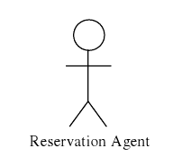
Actor
An Actor is a role of an object or objects outside of a system that interacts directly with it as part of a coherent work unit (a use case)
One physical object (or class) may play several different roles and be modeled by several actors
Notation
Example actors for an Airline Reservation system
  Airline administrators (fare/schedule setting)
  Travel Agent
  Airline Reservations Agent
  Check-in Agents at Airport
  Gate Agent at Airport

Slide 8
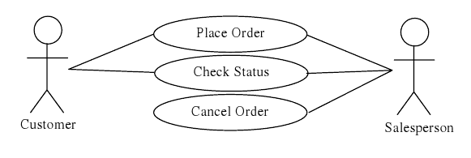
Use Case
A Use Case captures some actor-visible function
Achieves some discrete (business-level) goal for that actor
May be read, write, or read-modify-write in nature
Notation

Slide 9
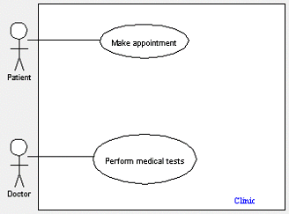
System boundary:
A system boundary defines the scope of what a system will be. A system boundary of a use case diagram defines the limits of the system. The system boundary is shown as a rectangle spanning all the use cases in the system.

Slide 10
Example of Use Case Diagram
registration
updating
grades
student
faculty
output
generating

Slide 11
Relationships between Use Cases
1. Generalization - use cases that are specialized versions of other use cases.
2. Include - use cases that are included as parts of other use cases. Enable to factor common behavior.
3. Extend - use cases that extend the behavior of other core use cases. Enable to factor variants.

Slide 12
1. Generalization
The child use case inherits the behavior and meaning of the parent use case.
The child may add to or override the behavior of its parent.
parent
child

Slide 13
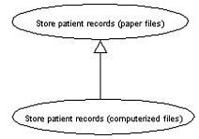
More about Generalization
registration
non-graduate
registration
graduate
registration

Slide 14
2. Include
The base use case explicitly incorporates the behavior of another use case at a location specified in the base.
The included use case never stands alone. It only occurs as a part of some larger base that includes it.
base
<<include>>
included
ניתוח מערכות מידע

Slide 15
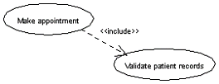
More about Include
Enables to avoid describing the same flow of events several times by putting the common behavior in a use case of its own.
updating
grades
<<include>>
verifying
student id
output
generating
<<include>>

Slide 16
3. Extend
The base use case implicitly incorporates the behavior of another use case at certain points called extension points.
The base use case may stand alone, but under certain conditions its behavior may be extended by the behavior of another use case.
base
<<extend>>
extending

Slide 17
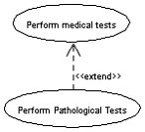
More about Extend
Enables to model optional behavior or branching under conditions.
The base use case is complete in and of itself
Exam copy request
<<extend>>
Exam-grade appeal

Slide 18
Relationships between Actors
Generalization.
student
graduate
student
non-graduate
student

Slide 19
Difference between Extend Relationship and Generalization Relationship
On the face of it, both generalizations and extends appear to be more or less similar. But there is a subtle difference between a generalization relationship and an extend relationship.
  a generalization relationship between use cases:
    the parent use case can be replaced by the child use case without breaking the business flow.
  an extend relationship between use cases:
    that the child use case enhances the functionality of the parent use case into a specialized functionality. The parent use case in an extend relationship cannot be replaced by the child use case.

Slide 20
